Slide 1
JavaScript ES6
Lesson 13:ES6 Introduction
Notes:
Add instructor notes here.

Slide 2
Lesson Objectives
At the end of this module you will be able to:
Explain the importance of ES6
ES6 compatibility with modern browsers
Run ES6 code in incompatible browsers using Transpilers like Babel, Traceur and TypeScript
Notes:
Add instructor notes here.

Slide 3

Introduction
JavaScript is a superset of ECMAScript scripting language.
ECMAScript forms the language base for JavaScript, JScript and ActionScript.
ES6 gives a vast makeover to JavaScript by adding new syntaxes and APIs to write complex applications and libraries that are easier to debug and maintain.
Notes:
Add instructor notes here.

Slide 4
Why ECMAScript 6 ?
JavaScript is extremely powerful and flexible, but it is often criticized for having unnecessary redundancy.
JavaScript developers often use abstractions such as CoffeeScript and Typescript, which provide easier syntax, powerful features, and compile to JavaScript.
ES6 was introduced to improve JavaScript and ensure that developers no longer needed to use abstractions or other techniques to write quality code, which leads to a lengthy process.
Notes:
ECMAScript is a scripting language standardized by Ecma International in the ECMA-262 specification and ISO/IEC 16262. Scripting languages such as JavaScript, JScript and ActionScript are supersets of ECMAScript. Although JavaScript, JScript, and ActionScript have more capabilities than ECMAScript, by defining more objects and methods, the core features of these languages are the same as ECMAScript.
ECMAScript 6 is the sixth version and the seventh edition of the ECMAScript language. In short, it is also called "ES6".
JavaScript was lacking behind some other programming languages when compared to various syntactic forms such as declaring constant variables, declaring block scoped variables, extracting data from arrays, shorter syntax for declaring functions and so on. ES6 adds up a lot of new syntax-based features to JavaScript, which helps the developers to write less and do more. ES6 also prevents programmers from using various hacks for achieving various goals, which have negative performance impact and made code harder to read. In this chapter, we will look at the new syntactic features, introduced by ES6.
Add instructor notes here.

Slide 5
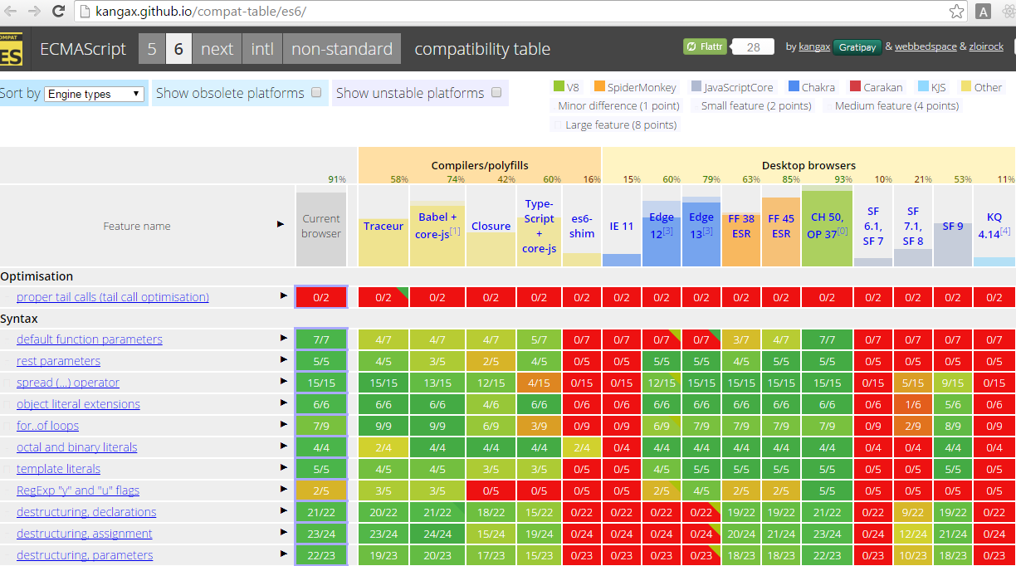
ES6 compatibility table
Notes:
Add instructor notes here.

Slide 6
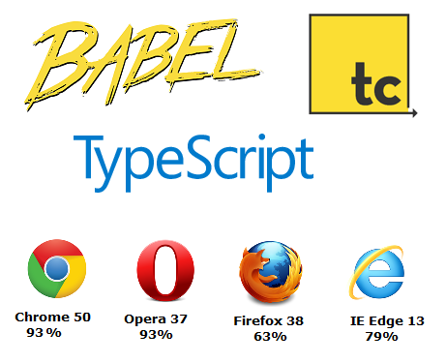
Running ECMAScript 6 in an Incompatible Browser
ES6 on development phase can embed the compiler like Babel, Type-Script, Traceur in the webpages which compiles the ES6 to simple browser supportable JavaScript code.
On production phase, It is recommended to use node compiler to compile and embed the compiled JS in web pages using the node packages of mentioned compilers.
Notes:
On production site compiling ES6 to browser supportable JS on every page load can be a resource & time consuming task and can effect the site performance.
We can use ES6 polyfills but Polyfill is not available for all ES6 feature.
Add instructor notes here.

Slide 7
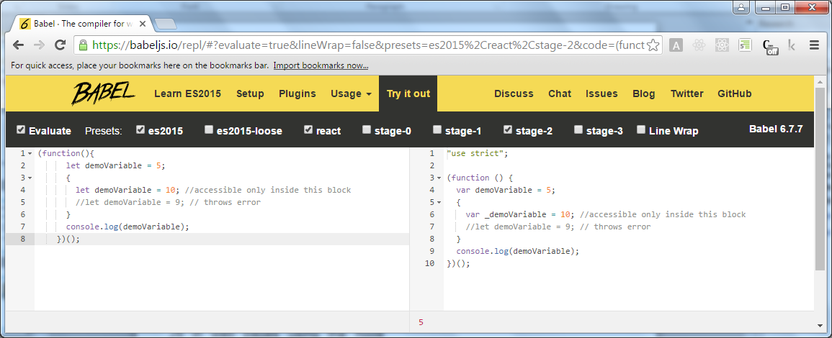
Compiling ES6 using Babel online compiler
Babel Transpiler
https://babeljs.io/repl/
Notes:
Add instructor notes here.

Slide 8
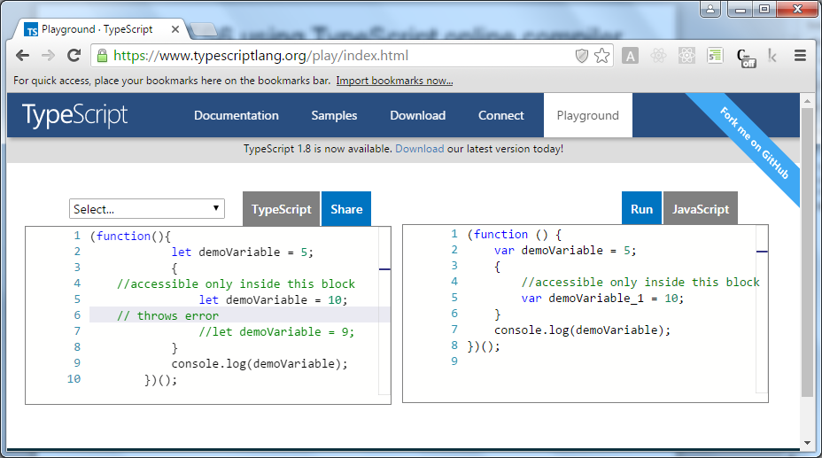
Compiling ES6 using TypeScript online compiler
TypeScript Transpiler
https://www.typescriptlang.org/play/index.html
Notes:
Add instructor notes here.

Slide 9
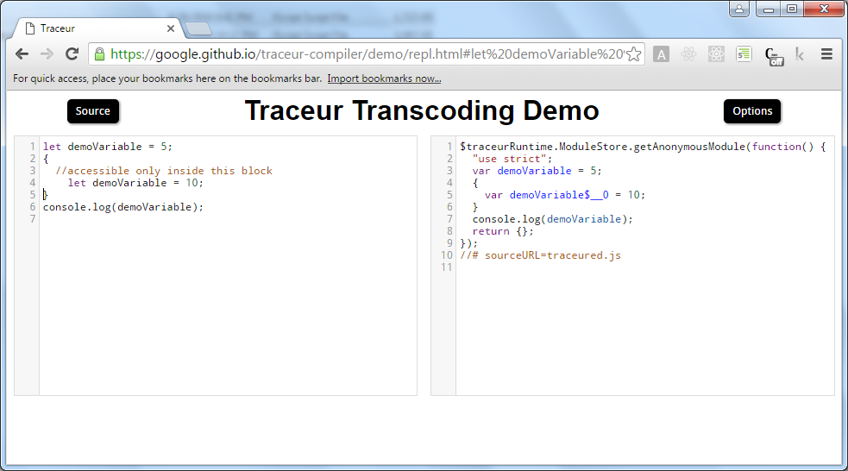
Compiling ES6 using Traceur online compiler
Traceur Transpiler
https://google.github.io/traceur-compiler/demo/repl.html#
Notes:
Add instructor notes here.

Slide 10
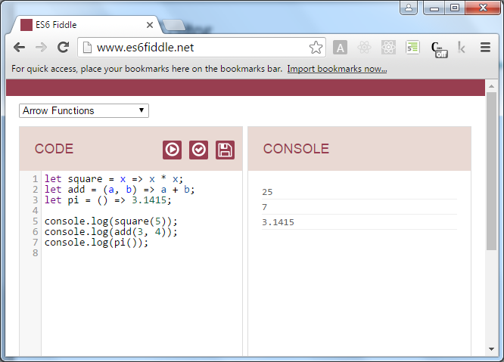
Online ES6 Editor – es6fiddle.net
http://www.es6fiddle.net/
Notes:
Add instructor notes here.

Slide 11

Summary
ECMAScript 2015 is the sixth version and the seventh edition of the ECMAScript language. In short, it is also called "ES6".
ES6 adds up a lot of new syntax-based features to JavaScript, which helps the developers to write less and do more.
Google Chrome and Opera supports most of the ES6 features.
In the production environment, It is recommended to use node compiler like babel, traceur and TypeScript to compile and embed the compiled JS.
Notes:
Add instructor notes here.

